Slide 1
ENTITY_- RELATIONSHIP MODEL
Entity Sets
Relationship Sets
Design Issues
Mapping Constraints
Keys
E–R Diagram
Extended E-R Features
Design of an E-R Database Schema
Reduction of an E-R Schema to Tables

Slide 2
ENTITY SETS
A database can be modeled as:
– a collection of entities,
– relationships among entities.
Entity: An entity is an object that exists and is distinguishable from other objects.
Example: specific person, company, event, plant
Mr.A with Aadhhar number 123455599 is an entity.

Slide 3
ENTITY SETS
An entity set
is a set of entities of the same type that share the same properties.
Example: set of all persons, companies, trees, holidays

Slide 4
ATTRIBUTES
An entity is represented by a set of attributes, that is, descriptive properties possessed by all members of an entity set.
Example:
Customer = ( customer-name,social-security,customer-street,customer-city)
account= ( account-number,balance)
Domain
– the set of permitted values for each attribute
Attribute types:
–Simple and composite attributes.
–Single-valued and multi-valued attributes.
Null attributes.
Derived attributes.

Slide 5
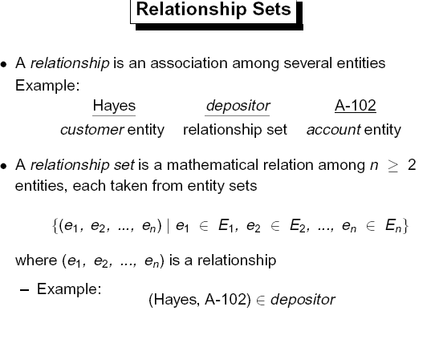

Slide 6
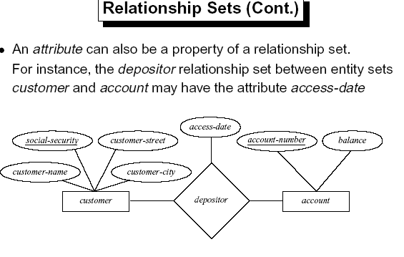

Slide 7
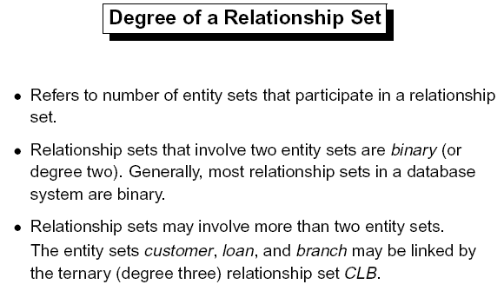

Slide 8
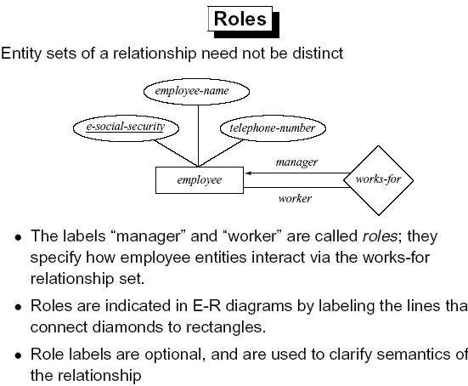

Slide 9
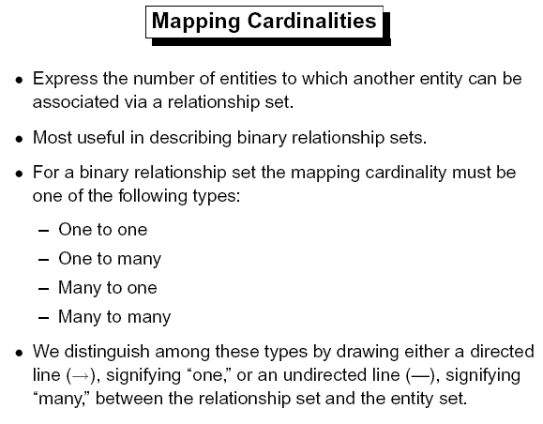

Slide 10
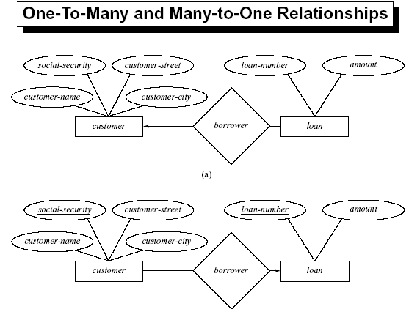

Slide 11
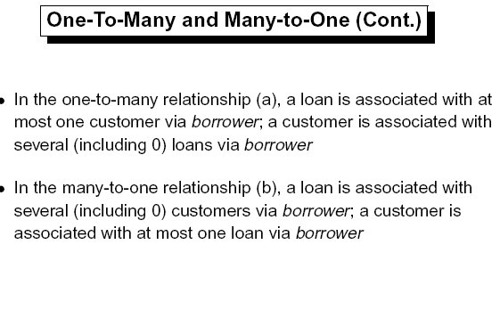

Slide 12
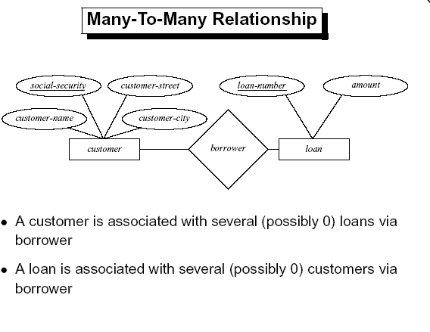

Slide 13
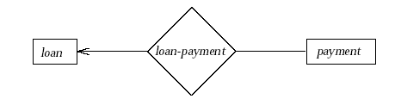
Existence Dependencies
If the existence of entity x depends on the existence of entity y, then x is said to be existence dependent on y.
–
Y is a dominant entity (in example below, loan)–
X is a subordinate entity
(in example below, payment)
If a loan entity is deleted, then all its associated payment entities must be deleted also.

Slide 14
KEYS
A super key of an entity set is a set of one or more attributes whose values uniquely determine each entity.
A candidate key of an entity set is a minimal super key
– social-security is candidate key of customer
– account-number is candidate key of account
Although several candidate keys may exist, one of the candidate keys is selected to be the primary key.

Slide 15
Student(sid, sname, addrees, branch, university-name, year_of_study, Date-of_birth)
Candidate Key: An attribute or combination attribute which uniquely identifies the entities of an entity set.

Slide 16
Keys
The combination of primary keys of the participating entity sets
forms a candidate key of a relationship set.
– must consider the mapping cardinality and the semantics of the relationship set when selecting the primary key.
– ( social-security, account-number) is the primary key of
depositor

Slide 17
E-R Diagram Components
Rectangles represent entity sets.
Ellipses represent attributes.
Diamonds represent relationship sets.
Lines link attributes to entity sets and entity sets to relationship sets.
Double ellipses represent multivalued attributes.
Dashed ellipses denote derived attributes.
Primary key attributes are underlined.

Slide 18
WEAK ENTITY SET
An entity set that does not have a primary key is referred to as a weak entity set.
The existence of a weak entity set depends on the existence of a strong entity set; it must relate to the strong set via a one-to-many relationship set.
The discriminator (or partial key) of a weak entity set is the set of attributes that distinguishes among all the entities of a weak entity set.

Slide 19
Weak Entity Set
The primary key of a weak entity set is formed by the primary key of the strong entity set on which the weak entity set is existence dependent, plus the weak entity set’s discriminator.

Slide 20
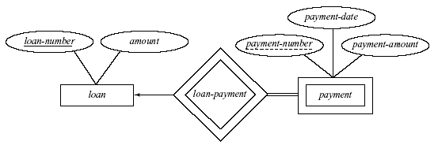
We depict a weak entity set by double rectangles.
We underline the discriminator of a weak entity set with a dashed line.
payment-number – discriminator of the payment entity set
Primary key for payment – ( loan-number, payment-number)

Slide 21
SPECIALIZATION
Top-down design process; we designate subgroupings within an entity set that are distinctive from other entitie in the set.
These subgroupings become lower-level entity sets that have attributes or participate in relationships that do not apply to the higher-level entity set.
Depicted by a triangle component labeled ISA (i.e., savings-account “is an” account)

Slide 22
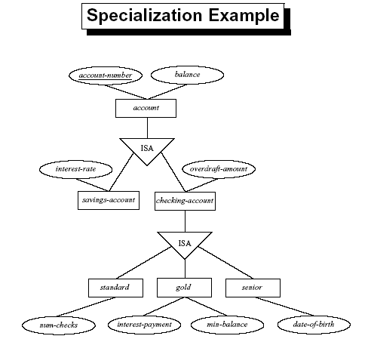

Slide 23
GENERALIZATION
A bottom-up design process – combine a number of entity sets that share the same features into a higher-level entity set
Specialization and generalization are simple inversions of each other; they are represented in an E-R diagram in the same way.
Attribute Inheritance – a lower-level entity set inherits all the attributes and relationship participation of the higher-level entity set to which it is linked.

Slide 24
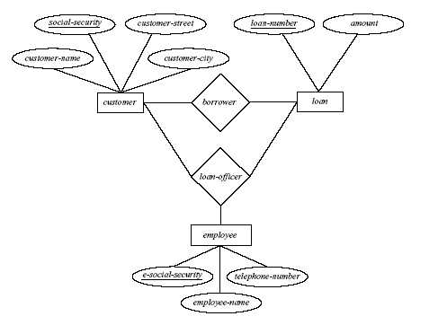
AGGREGATION
Loan customers may be advised by a loan-officer.

Slide 25
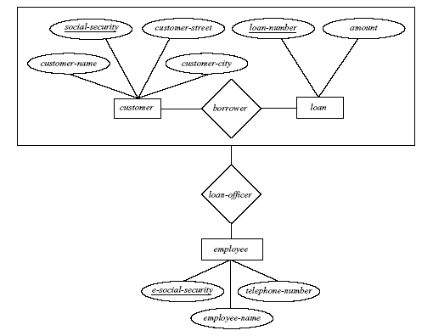
AGGREGATION EXAMPLE

Slide 26
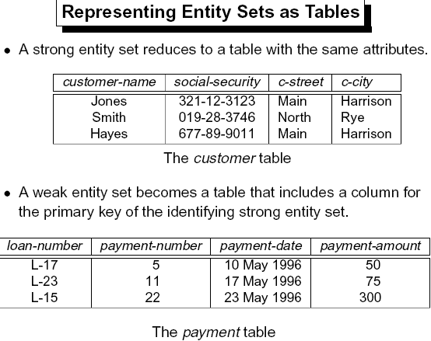

Slide 27
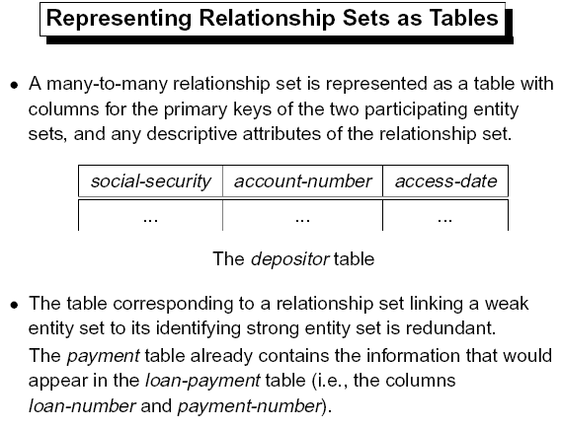

Slide 28
CONCLUSION
Helps in database design
Models the real world
Visual representation
Performed before normalization
Relationships can be established depending on the application

